Slide 1

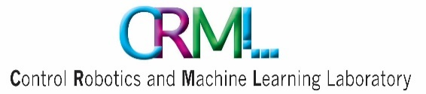
Speech Recognition Challenge
Using Deep Neural Networks
Etai Wagner& Eyal Ben David
Supervisor: Guy Adam
Notes:
Etai:

Slide 2
Today’s Agenda
Overview
About The challenge
Project Goals
Data exploration
Our Solution
Results
Conclusions
Notes:
Etai:

Slide 3
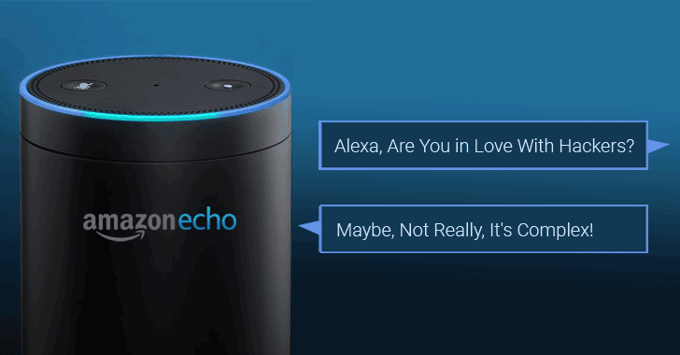
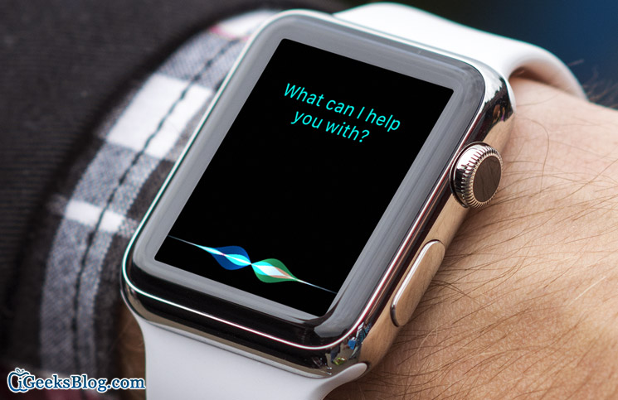
Overview
Motivation for developing better speech Recognition algorithms
Familiar examples are 'Siri', 'Alexa'
Notes:
Etai:

Slide 4
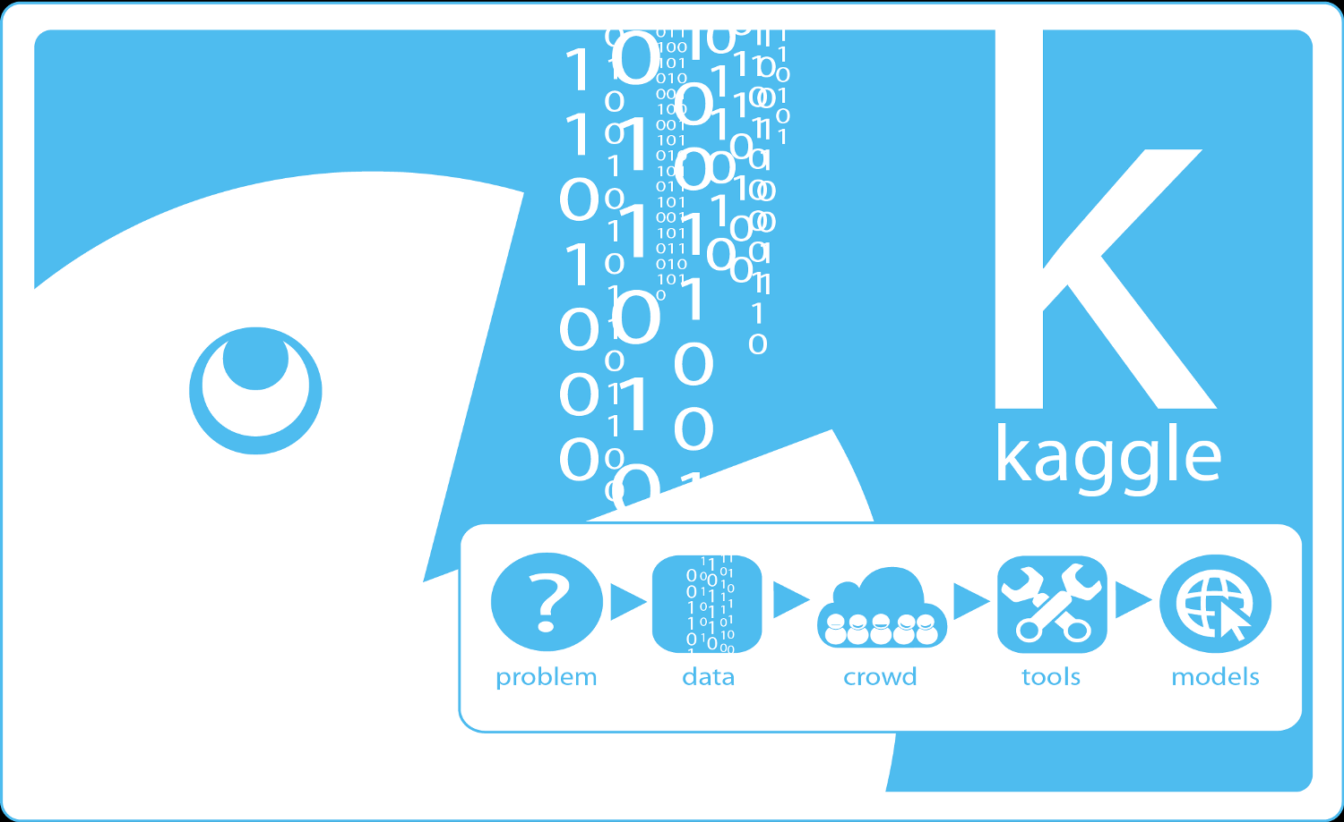
Overview
What is Kaggle Challenge?
Kaggle is the world's largest community of data scientists and machine learners offering machine learning competitions.
Notes:
Etai:

Slide 5
Overview
Our challenge
TensorFlow Speech Recognition Challenge:
Can you build an algorithm that understands simple speech commands?
Notes:
Etai:
In this competition, you're challenged to use the Speech Commands Dataset to build an algorithm that understands simple spoken commands. By improving the recognition accuracy of open-sourced voice interface tools, we can improve product effectiveness and their accessibility.

Slide 6
Project Goals
Build a speech recognition classifier using deep neural networks
Explore usage of preprocessing for audio/speech data
Explore new architecture concepts for this type of classifier
Reach top 10% score on the competition leaderboard
Notes:
Etai:

Slide 7
Literature Survey
"HYBRID SPEECH RECOGNITION WITH DEEP BIDIRECTIONAL LSTM" - TIMID dataset state of the art, 2013
"END-TO-END SPEECH RECOGNITION IN ENGLISH AND MANDARIN" - predict characters from audio records using CNN-RNN(GRU)-NN architecture, 2016
Notes:
Eyal:
1) Bidirectional LSTM that had achieved state of the art for the TIMID dataset, which is build of American speakers recordings of different sex for automatic speech recognition systems, they are using raw data.
2) predicting characters using spectrograms of parts of words and predicting the next character using previous detections and current input

Slide 8
Data Exploration
Known classes: 'Yes', 'No', 'Up', 'Down', 'Left', 'Right', 'On', 'Off', 'Stop', 'Go'
Unknown classes: 'Unknown', 'Silence'
Training Set - 67,096 examples
validation Set - 19,901 items
Notes:
Eyal:
Total of 12 classes, ten are known words and two are silence and unknown words
A bit of numbers: total of ~70k train examples and ~20k validation examples
This is before augmentation

Slide 9
Training Data
No silence is given
~45,000 examples from 'Unknown' class
Data is not noisy
~1 second recordings
Notes:
Eyal:
We didn’t get any silence examples, which is problematic because we don’t know its percentage in the test data

Slide 10

Training Examples
Stop
On
Down
Unknown
Notes:
Eyal:
(only 2 examples)

Slide 11
Test Data
Should have same distribution as train
Not very similar to training data
~1 second recordings
Notes:
Eyal:

Slide 12
Test Examples
Stop
On
Off
Silence
Left/Right
Unknown
Notes:
Eyal:
(only 2 or 3 examples)

Slide 13
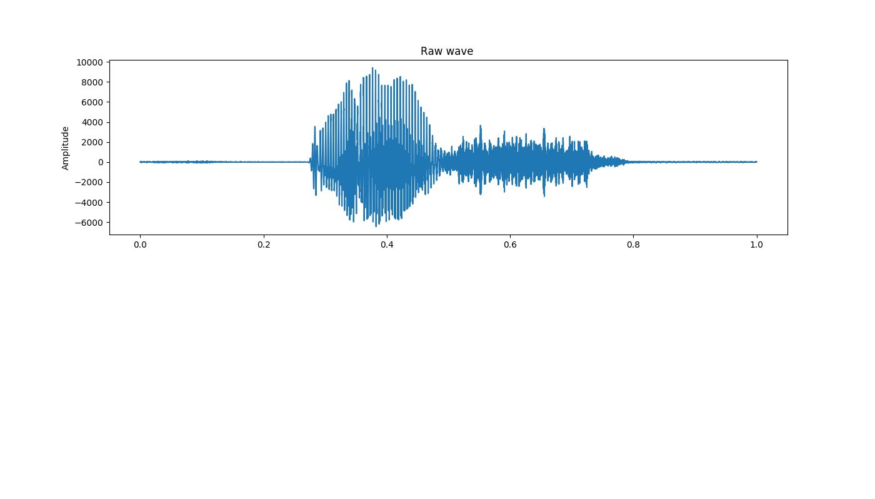
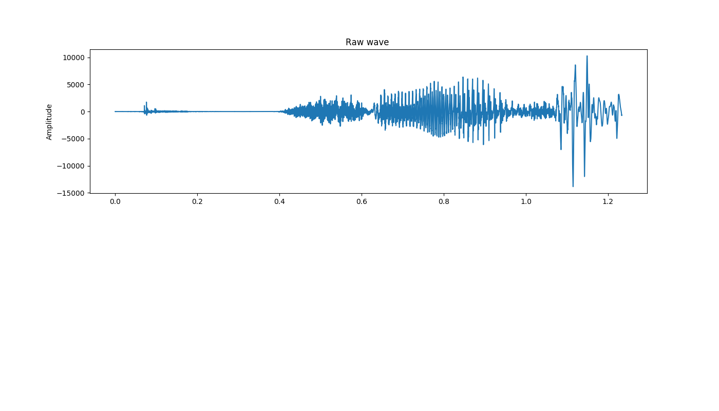
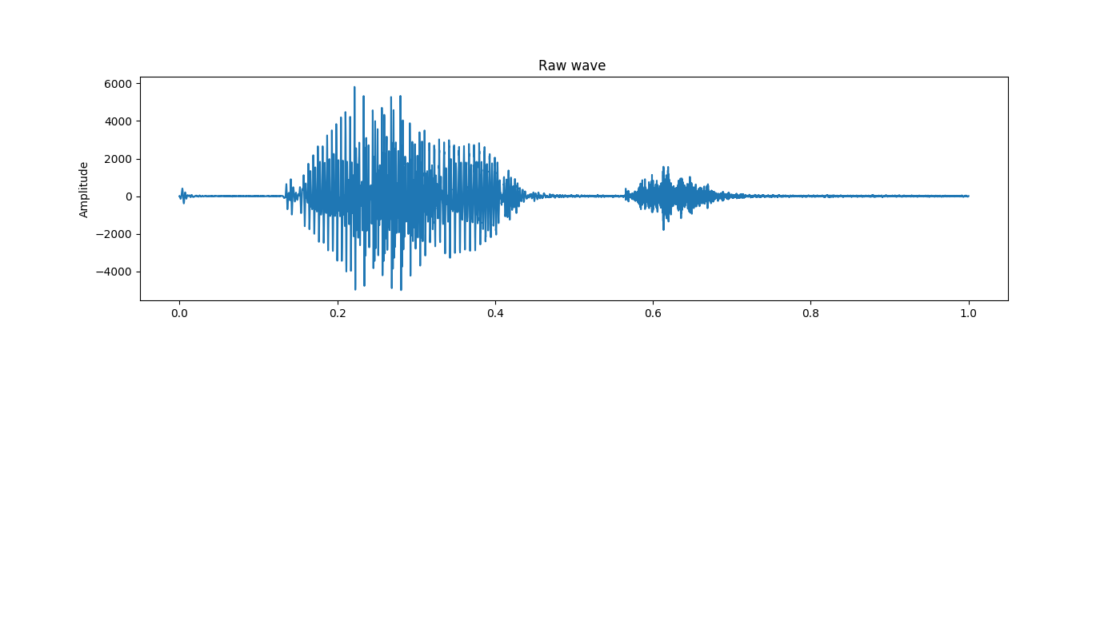
Audio Signal Recognition
Visualization of the data set
Yes
Unknown
Right
Notes:
Eyal:
Sample rate is 16,000 hz

Slide 14
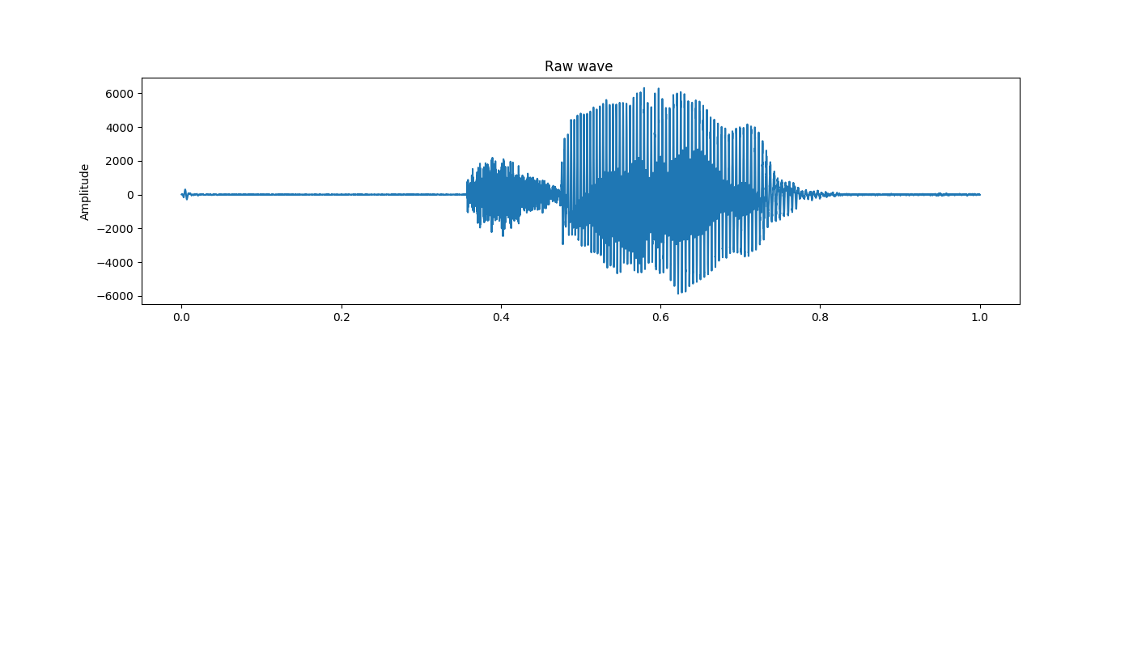
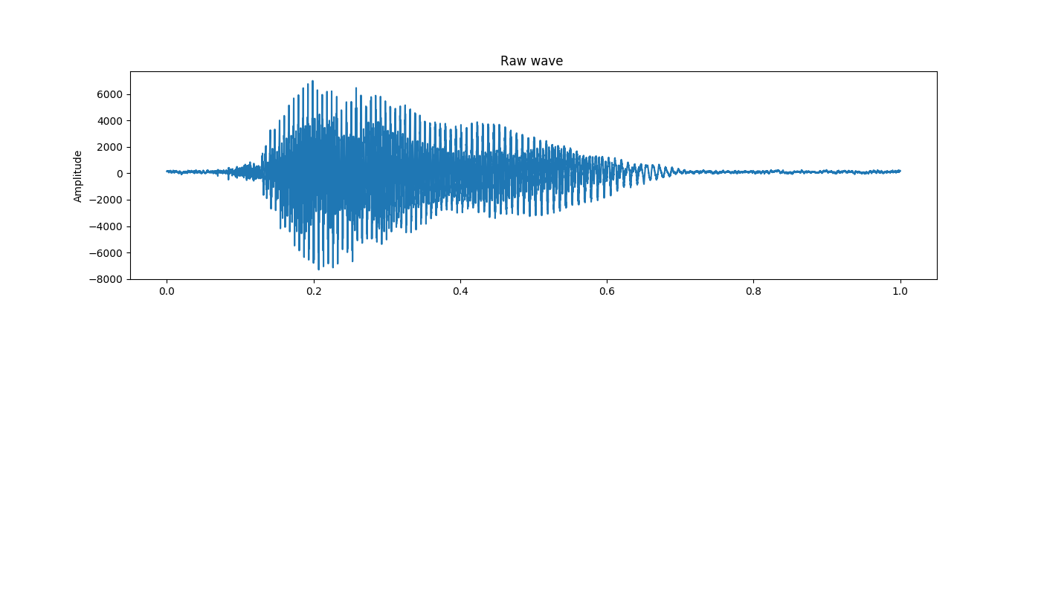
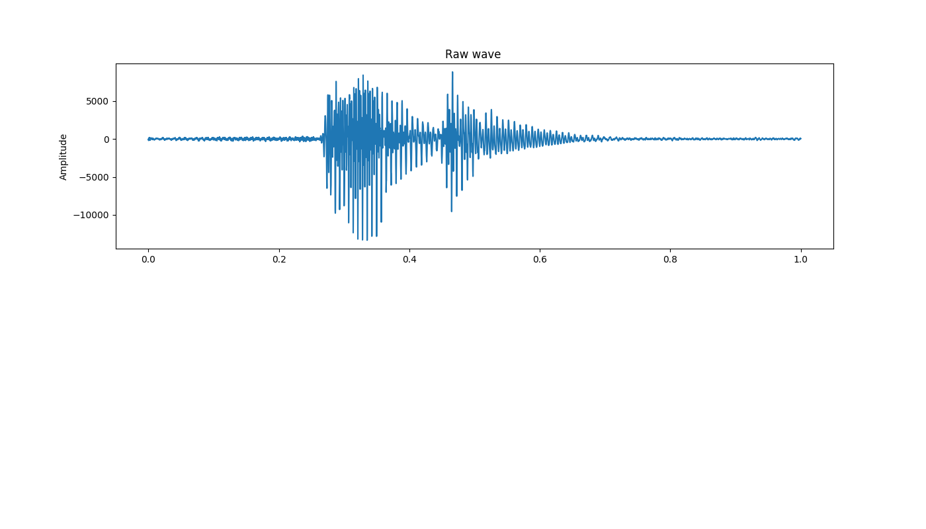
Audio Signal Recognition
Visualization of the data set
Tree
Three
Seven
Notes:
Eyal:

Slide 15

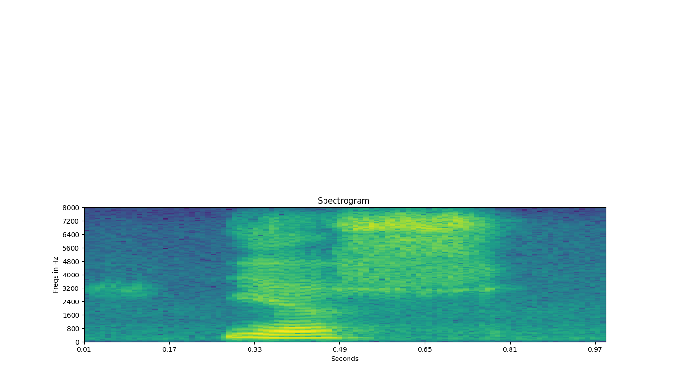
Common Solution at Kaggle
Feature extraction
Classifier
Raw Audio Data
Spectrogram
Fully Connected layers
Pre-Trained CNN
"YES"
Notes:
Eyal:
Many ensambel

Slide 16
Our Proposed Solution
Raw Audio Data
Augmentation&
Preprocess
Feature Extraction
Classifier
"YES"
Notes:
Etai:

Slide 17

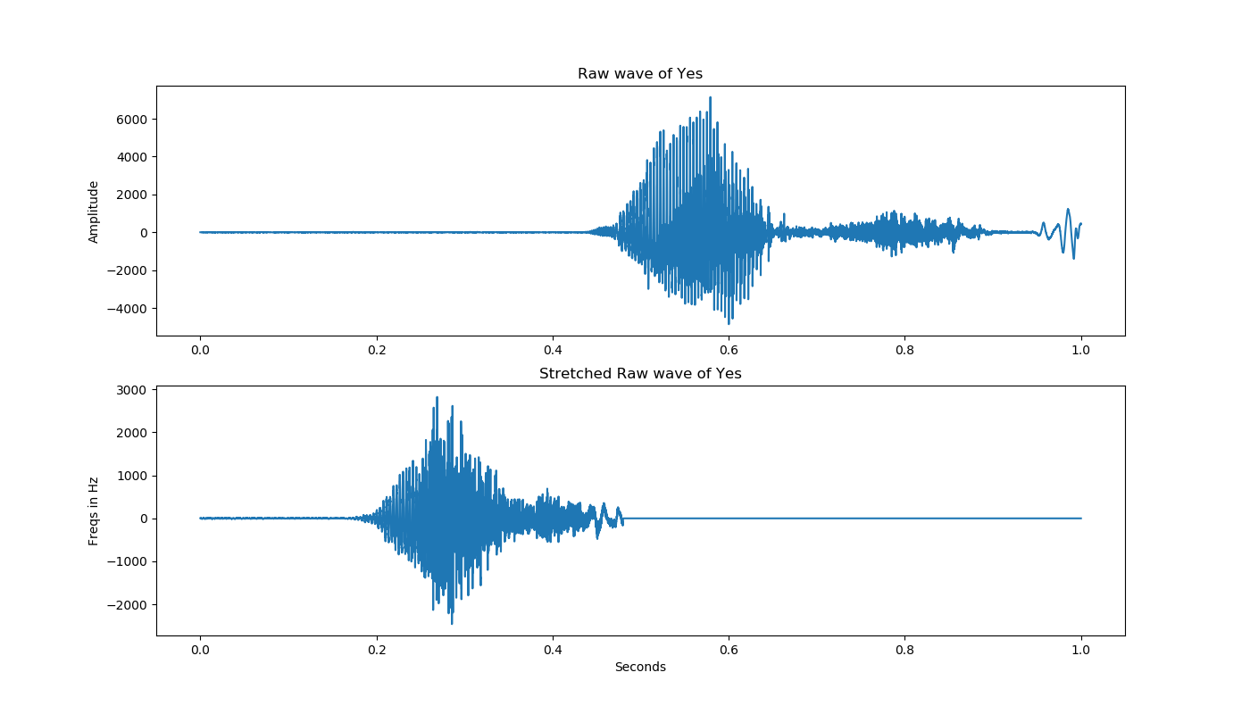
Proposed Solution - Augmentation
Aug
Ex
Cla
Stretch Raw Data - factor 0.5
Notes:
Etai:

Slide 18
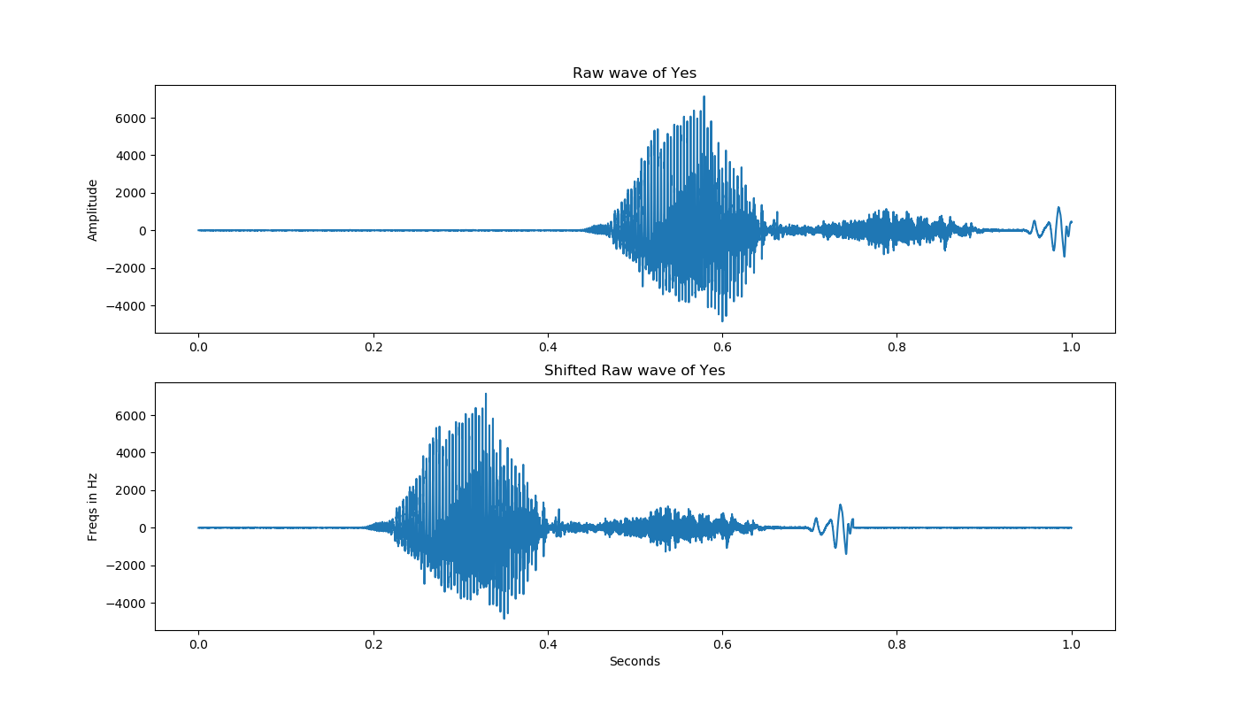
Proposed Solution - Augmentation
Shift Raw Data
Notes:
Etai:

Slide 19
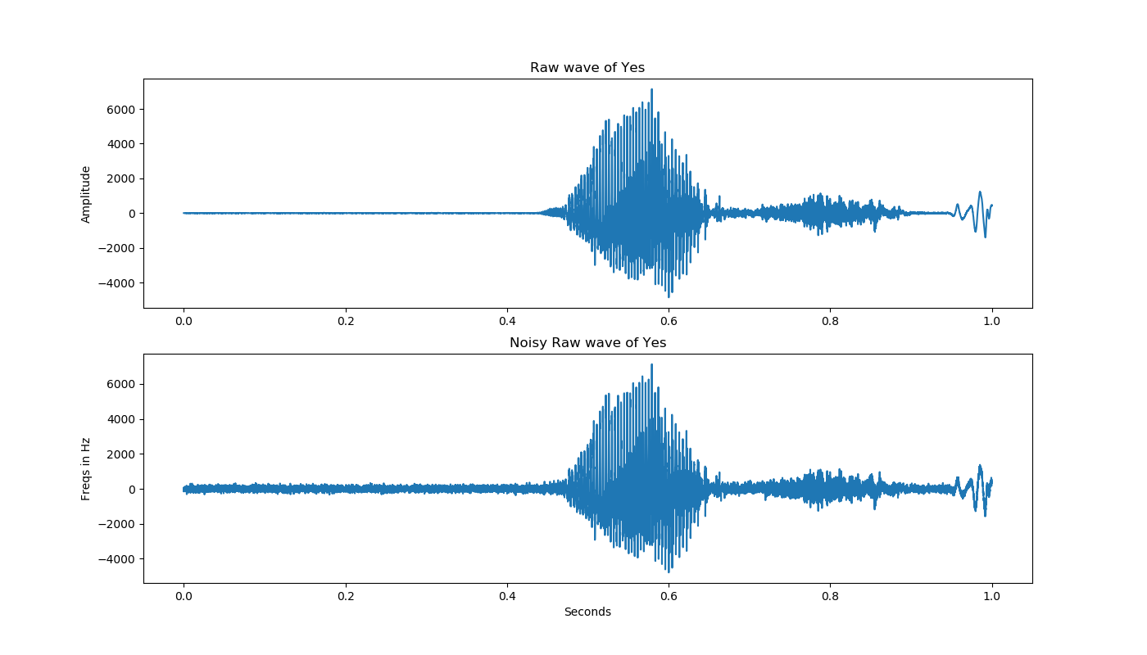
Proposed Solution - Augmentation
Noise Raw Data
Notes:
Etai:

Slide 20
Proposed Solution - Preprocess
Pre
Ex
Cla
Spectrogram is a visual representation of the spectrum of
frequencies as they vary with time
Spectrogram
Yes Raw Data
Yes Spec
Notes:
Etai:

Slide 21
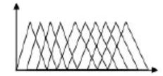
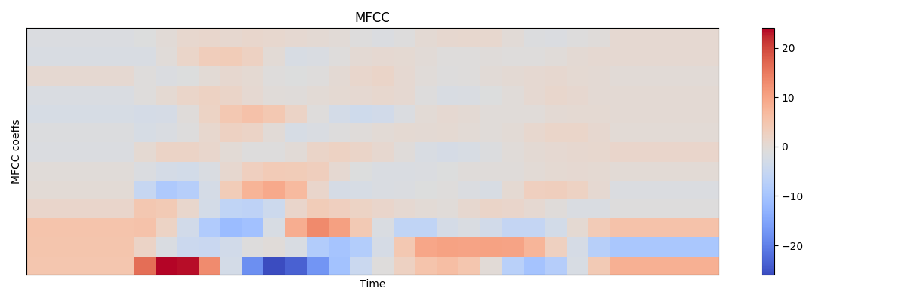
Proposed Solution - Preprocess
Mel-frequency cepstral coefficients a representation
of the short-term power spectrum of a sound, based on a linear cosine transform of a log power spectrum on a nonlinear mel scale of frequency.
Fourier
Transform
Log
DCT
Notes:
Etai:

Slide 22
Our Proposed Solutions
Raw Audio Data
Augmentation&
Preprocess
Feature Extraction
Classifier
"YES"
Notes:
Eyal:

Slide 23
Proposed Solution – option 1
Adding an LSTM layer to further extract temporal features and find temporal dependencies
Feature extraction
Feature extraction
Raw Audio Data
Spectrogram
Classifier
Convolutional layers
LSTM
Fully Connected layers
"YES"
Notes:
Eyal:

Slide 24


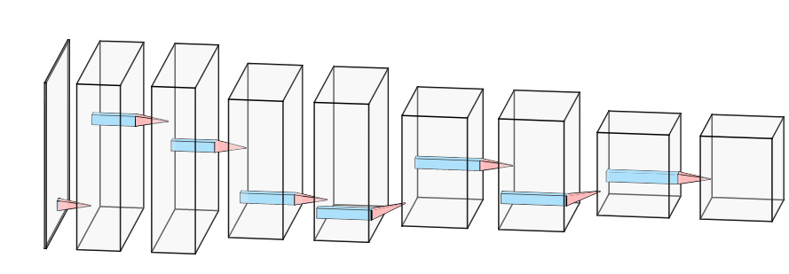
Architecture - Embedding
conv
LSTM
fully
(64X128X1)
(64X128X16)
(64X128X16)
(32X64X32)
(32X642X32)
(16X32X64)
(16X32X64)
(8X16X96)
(8X16X96)
Notes:
Eyal:

Slide 25
Time Dimension In Last Layer
8
16
Time
Notes:
Eyal:

Slide 26
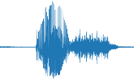

LSTM
conv
LSTM
fully
(96,64)
LSTM Unit
(64)
(8)
0
1
2
3
4
5
6
15
(96)
Notes:
Eyal:

Slide 27
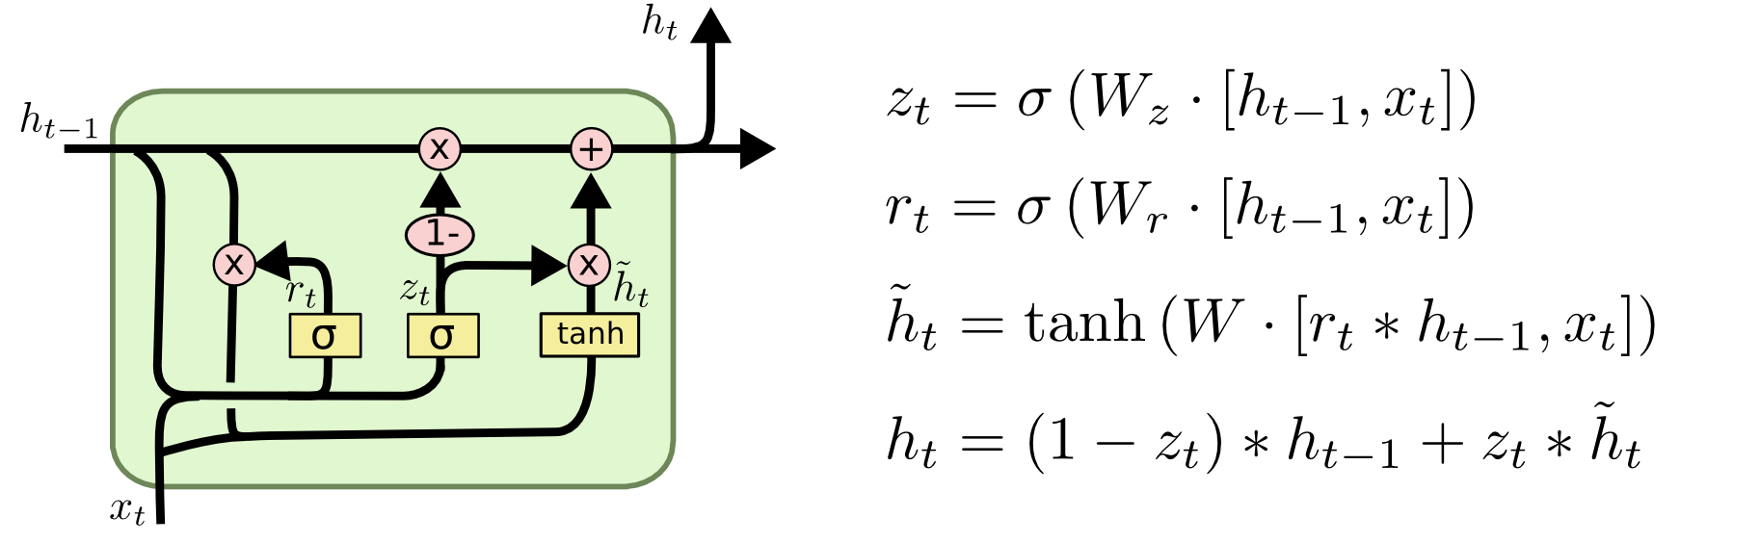
LSTM

Slide 28
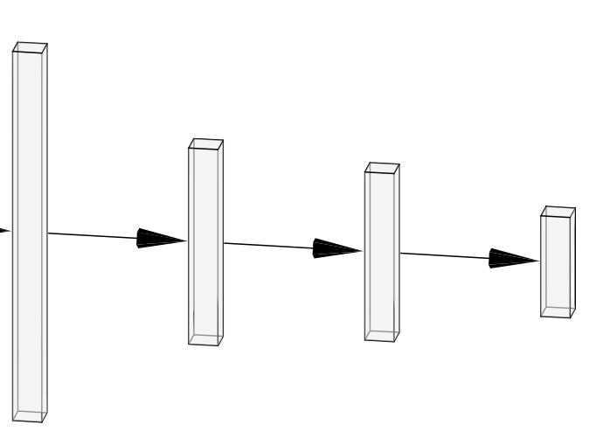
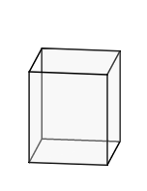

Architecture - LSTM & FC
conv
LSTM
fully
(6144)
(128)
(96X8X16)
(64)
LSTM
(12)
Flatten
Notes:
Etai:

Slide 29
Proposed Solution – option 2
2 Inputs Outline
An intelligent way for combing two different input sources.
Embedding
+
Decision
Making
"YES"
Embedding
Notes:
Eyal:

Slide 30
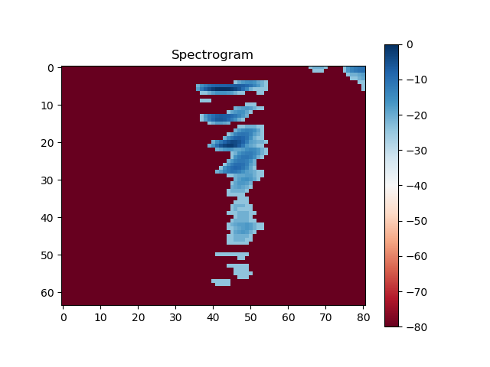
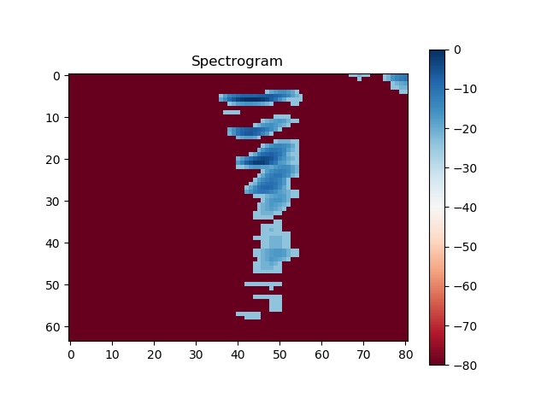

Proposed Solution – option 3
Hop length = 200
3D Spectrograms/
Multichannel Spectrogram
Hop length = 350
Hop length = 450
Notes:
Eyal:

Slide 31
Our Proposed - Architecture
3D input
Each channel contains a different spectrogram generated with a smaller widow size
LSTM
&
Decision
Making
Embedding
"YES"
Notes:
Eyal:

Slide 32
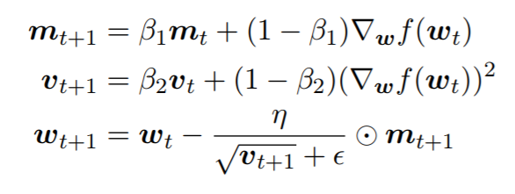
Adam Optimizer
Adaptive Moment Estimation (Adam)
aims to incorporate both momentum and adaptive learning rate into a single algorithm
A rough idea for the update rule is (typically, β1 = 0.9, β2 = 0.999):
Problem - what happens early in the training process?

Slide 33
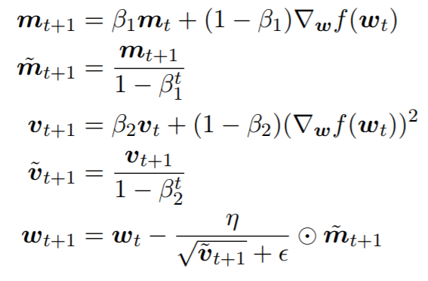
Adam Optimizer
Solution - scale the moments’ estimates in order to correct the zero-bias.
The final update rule is (typically, β1 = 0.9, β2 = 0.999):

Slide 34
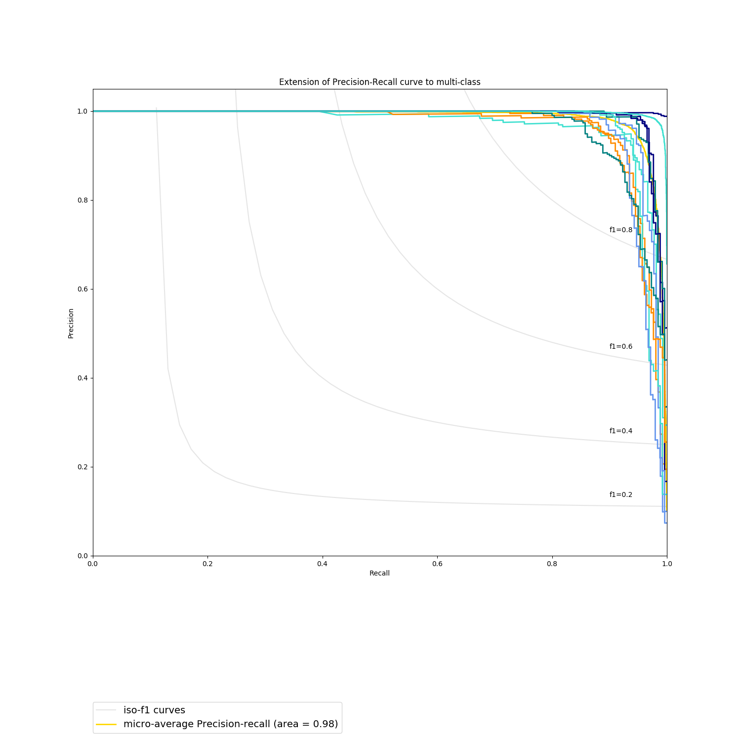
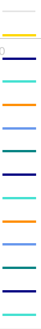
Results - Precision Recall
Iso-f1 curves
Micro-average Precision-recall (area=0.98)
Precision-recall for 'Yes' (area=0.99)
Precision-recall for 'No' (area=0.97)
Precision-recall for 'Up' (area=0.97)
Precision-recall for 'Down' (area=0.98)
Precision-recall for 'Left' (area=0.99)
Precision-recall for 'Right' (area=0.99)
Precision-recall for 'On' (area=0.97)
Precision-recall for 'Off' (area=0.97)
Precision-recall for Stop' (area=0.96)
Precision-recall for Go' (area=0.97)
Precision-recall for 'Silence' (area=1.00)
Precision-recall for 'Unknown' (area=1.00)
Notes:
Etai:
Percision shows results relevancy
Recall shows how many truly relevant results are returned
F1 is harmonic mean of precision recall = 2*(p*r)/(p+r)
Green has dificults because 'go' & 'no' are similar

Slide 35
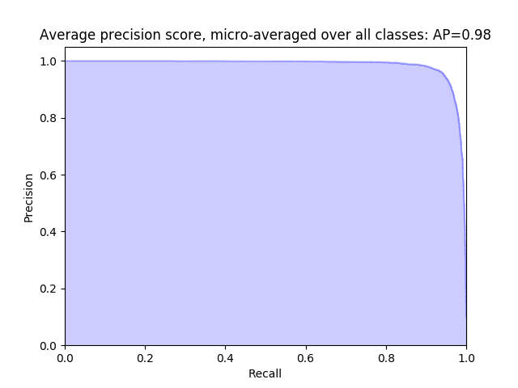
Results - Precision Recall
Validation Score = [0.25199641659826544, 0.965225858804436]
Notes:
Etai:

Slide 36
Results
private score is the score on the whole test set, while public score is just the score on a fraction of the test set.
Public Score (Part Of Test Set) | Private Score (whole Test Set) | Data | Architecture
0.75575 | 0.75930 | Basic | CNN-NN
0.80482 | 0.80253 | Aug | CNN-NN
0.78755 | 0.78832 | Basic | CNN-LSTM-NN
0.81798 | 0.81839 | Aug | CNN-LSTM-NN
0.85498 | 0.86291 | Aug, 'Silence' | CNN-LSTM-NN
0.88185 | 0.89157 | Aug, 'Silence' | 128-CNN-LSTM-NN*
0.86130 | 0.86582 | Aug, 'Silence' | 2 Inputs *
0.83771 | 0.84564 | Aug, 'Silence' | 3D input*
0.90296 | 0.91060 | CNN | Best Score*
* used ensemble
Notes:
Etai:
TALK ABOUT WHY 2-INPUTS & 3D DIDN’T SUCCEED!!!!!

Slide 37



Test Classification Examples
Some difficult examples in test data:
Very silent 'Up' and noisy 'Silence'
Difference between 'On' and 'Off'
Difference between 'Go' and 'No'
Notes:
Etai:

Slide 38
Summary and Conclusions
We devised and tested new Deep Neural network architectures for speech recognition
Time dimension contains valuable information
We achieved State of the art results
Speech recognition is a difficult problem and there is still a way to go until human like abilities are achieved
Notes:
Etai:

